Slide 1

Using Kubernetes
Day 1
Nesia Amit

Slide 2
Agenda
Microservices Architecture
Microservices Architecture
What is Kubernetes?
Kubernetes Basics
Kubernetes Concepts

Slide 3
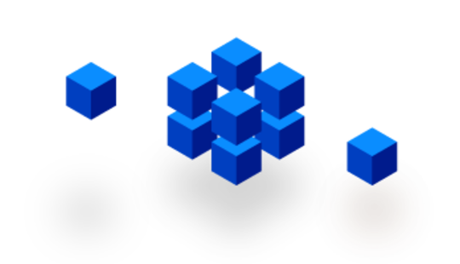

Microservices

Slide 4
Typical MVC Application
User Interface
What if the application keeps growing?
Business-Logic
Controllers
Data Layer
DB Models
DB

Slide 5
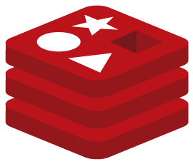
Typical MVC Application
User Interface
Adding more and more functionality until…
Order
Jobs
Business-Logic
OAuth
Upload Files
Controllers
Mgmt
Acct
Data Layer
FS Models
DB Models
FS
DB

Slide 6
Monolithic Architecture
User Interface
It becomes a massive monolith that is almost impossible to maintain and eats way too much CPU and RAM.
Order
Jobs
Business-Logic
OAuth
Upload Files
Controllers
Mgmt
Acct
Data Layer
FS Models
DB Models
FS
DB

Slide 7
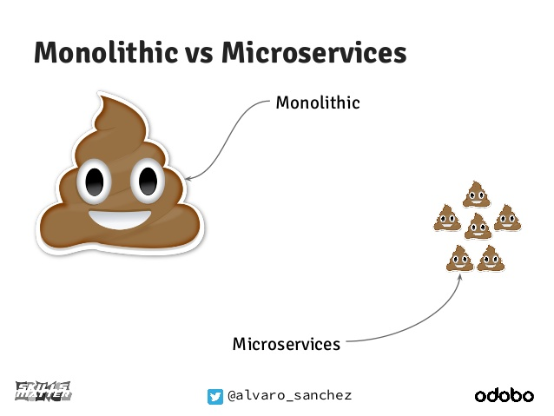

Slide 8
Split the application into smaller chunks
User Interface
Mgmt
OAuth
Controllers
DB Models
Upload Files
User Interface
Jobs
Acct
Acct
Jobs
Mgmt
Controllers
FS Models
OAuth
Upload Files
DB Models
Business-Logic
Data Layer
FS Models
DB Models
FS
DB

Slide 9
Split the application into smaller chunks
User Interface
http
Mgmt
http
OAuth
http
Controllers
http
http
Upload Filed
DB Models
Jobs
Acct
FS Models
DB Models
FS
DB

Slide 10
Host-centric Infrastructure
http
User Interface
=
The old way to deploy applications
heavyweight, non-portable, Relies on OS package manager
Mgmt
http
OAuth
http
Controllers
http
http
Upload Files
DB Models
sinatra
Jobs
Acct
rails
vanila
rails
FS Models
State-machines
DB Models
bundler
rails
unicorn
sidekiq
Binaries/Libraries
libyaml
libxslt
libicu
Ruby
Node
npm
Java
libssl
libxml
libpq
Mysql-Client
Redis-tools
Host Operating System Kernel

Slide 11


Container-centric Infrastructure
User Interface
http
Bin/Lib
OAuth
=
The new way to deploy applications
Small and fast, portable, Uses OS-level virtualization
Bin/Lib
http
http
Mgmt
Bin/Lib
Controllers
http
DB Models
http
Bin/Lib
Upload Files
Jobs
FS Models
Acct
DB Models
Bin/Lib
Bin/Lib
Bin/Lib
Docker Engine or (rkt)
Binaries/Libraries
Host Operating System Kernel

Slide 12
Containers Benefits
Loosely coupled, distributed, elastic, liberated micro-services
Application-centric management
Environmental consistency across development, testing, and production
Continuous development, integration, and deployment
Resource isolation

Slide 13
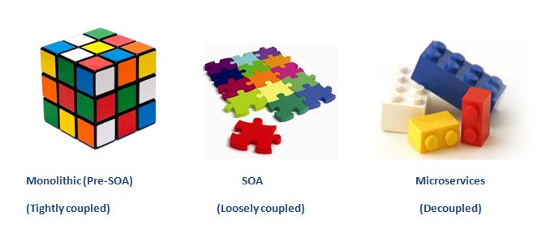
Monolithic – Service Oriented - Microservices

Slide 14
Agenda
A microservice is an isolated, loosely-coupled unit of development that works on a single concern.
Microservices Architecture
What is Kubernetes?
What is Kubernetes?
Kubernetes Basics
Kubernetes Concepts

Slide 15
First, think about challenges like….
Auto Deploy
Auto Scale
Rolling-Update
Load-Balancing
Service Discovery
Health-Check
Configuration
Storage Management
Monitoring-tools

Slide 16
Auto Deploy
Auto Scale
VM#3
VM#1
VM#2

Slide 17
Load Balancing
VM#3
VM#1
VM#2

Slide 18
Service Discovery
red:1880
VM#3
VM#1
VM#2

Slide 19
Zero Downtime deploys
VM#3
VM#1
VM#2

Slide 20
Health Checks
VM#3
VM#1
VM#2

Slide 21
Distribute Configuration and Secrets
VM#3
VM#1
VM#2

Slide 22
Storage Management
VM#3
VM#1
VM#2

Slide 23
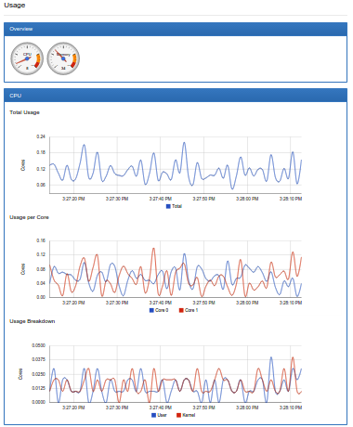
Monitoring Resources
VM#3
VM#1
VM#2

Slide 24
How can we meet the challenges?

Slide 25

Containers Orchestrator
The main players:
Kubernetes
AWS ECS
Docker Swarm
Kubernetes has the largest community and is the most popular by a big margin

Slide 26
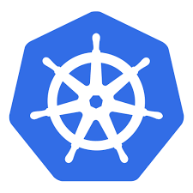
Kubernetes (aka. K8s)
Kubernetes is an open-source started in 2014 by Google.
Community includes Google, Red Hat, and over 2000 authors. (Source: CNCF)
The name Kubernetes originates from Greek, meaning helmsman

Slide 27
Agenda
A microservice is an isolated, loosely-coupled unit of development that works on a single concern.
Microservices Architecture
Kubernetes is an open-source platform designed to automate deploying, scaling, and operating application containers.
What is Kubernetes?
Kubernetes Basics
Kubernetes Basics
Kubernetes Concepts

Slide 28
Pod - the basic building block of Kubernetes
IP address
10.10.10.2
Containerized app
VM#3
VM#1
VM#2

Slide 29
Pod
A Pod is the smallest and simplest unit in the Kubernetes object model that you create or deploy.
A Pod represents a unit of deployment: a single instance of an application in Kubernetes, which might consist of either a single container or a small number of containers that are tightly coupled and that share resources.
Pods are designed as relatively ephemeral, disposable entities.
Pods are managed in Kubernetes via Controllers

Slide 30
Controller
A Controller can create and manage multiple Pods for you, handling replication and rollout and providing self-healing capabilities at cluster scope.
Some examples of Controllers:
Deployment
StatefulSet
DaemonSet

Slide 31
Master
Pod
Deployment
D
D
D
Docker
kublet
kublet
Docker
Node
Node Processes
Kubernetes Cluster
kublet
Docker

Slide 32

kubectl run my-app …
D
Master
Node#3
Docker
kublet
Node#1
kublet
Docker
Node#2
Kubernetes Cluster
kublet
Docker

Slide 33
web-service :80
Lets-Chat-Web
(Nginx)
Lets-Chat-Web
(Nginx)
Lets-Chat-Web
(Nginx)
app-service :8080
Lets-Chat-App
(Node.js)
Lets-Chat-App
(Node.js)
Lets-Chat-App
(Node.js)
web-service :27017
Lets-Chat-DB
(MongoDB)

Slide 34
Working with kubectl Imperative Commands
Deploy and Explore an Application (Lab: task-1)
# create a Deployment called ‘my-app’ which starts
# a single pod with nginx container listening on port 80
$ kubectl run my-app --image=nginx --port=80
# list all pods
$ kubectl get po
# stream pod logs (stdout)
$ kubectl logs –f my-app-pod-name
# run command in a pod
$ kubectl exec –it my-app-pod-name bash
# forward port 80 of pod to port 10080 on your local machine
$ kubectl port-forward my-app-pod-name 10080:80

Slide 35
kubectl expose deploy …
10.30.0.2:5672
10.40.0.2:80
D
D
Master
10.97.14.200:5673
10.105.128.60:8080
Node#3
S
S
kublet
Docker
Node#1
kublet
Docker
10.32.0.3:5672
10.43.0.2:80
Node#2
Kubernetes Cluster
kublet
Docker

Slide 36
Service
A Service routes traffic across a set of Pods
The set of Pods targeted by a Service is usually determined by a LabelSelector
A Service is an abstraction that allow pods to die and replicate in Kubernetes without impacting your application.
Discovery and routing among Pods is handled by Kubernetes Services.

Slide 37
Working with kubectl Imperative Commands
Expose and Scale your Application (Lab: task-2)
# Create a service for my-app deployment, on port 80 and connects to the containers on port 8000.
$ kubectl expose deployment my-app --port=80 --target-port=8000
# List all services
$ kubectl get svc
# List pods and show all labels as the last column
$ kubectl get po --show-labels
# Scale a deployment named 'foo' to 3.
$ kubectl scale deploy my-app --replicas=3

Slide 38
Agenda
A microservice is an isolated, loosely-coupled unit of development that works on a single concern.
Microservices Architecture
Kubernetes is an open-source platform designed to automate deploying, scaling, and operating application containers.
What is Kubernetes?
Using kubectl imperative commands to Deploy, Explore, Expose, Scale your Application
Kubernetes Basics
Kubernetes Concepts
Kubernetes Concepts

Slide 39
Defining a Service
A Service in Kubernetes is a REST object, meaning its definition can be POSTed to the apiserver to create a new instance.
This specification will create a new Service object named “my-service” which targets TCP port 80 on any Pod with the "app=MyApp" label.
my-service.yaml
kind: Service
apiVersion: v1
metadata:
name: my-service
spec:
selector:
app: MyApp
ports:
- protocol: TCP
port: 8080
targetPort: 80
# Create a service from a file.
$ kubectl create –f my-service.yaml

Slide 40
Endpoints
Once a Service object with selector is created, it will be assigned with virtual IP and – a corresponding Endpoints object is also created.
kind: Service apiVersion: v1 metadata: name: my-service spec:
clusterIP: 10.106.92.105
selector: app: MyApp ports: - protocol: TCP port: 8080 targetPort: 80
kind: Endpoints apiVersion: v1 metadata: name: my-service
labels:
app: MyApp
subsets: - addresses: - ip: 10.10.10.2
- addresses: - ip: 10.10.10.3
ports: - port: 80
10.10.10.2:80
my-app
kubelet
Dock
10.10.10.3:80
my-app
kubelet
Dock

Slide 41
kube-apiserver notifies kube-proxy on every Node on new Service and Endpoints Objects:
kube-apiserver
kubelet
Dock
kubelet
Dock
10.10.10.2:80
my-app
kube-proxy
Iptables for service (with virtual ip) and endpoints
-A KUBE-SEP-57K ...
-A KUBE-SEP-5RZ ….
-A KUBE-SERVICES ….
-A KUBE-SVC-NW ...
-A KUBE-SVC-NV5 ….
kubelet
Docker

Slide 42
Discovering Services – kube-dns
The DNS server watches the Kubernetes API for new Services and creates a set of DNS records for each.
If DNS has been enabled throughout the cluster then all Pods should be able to do name resolution of Services automatically.

Slide 43
Defining a Deployment
my-deploy.yaml
apiVersion: apps/v1beta2
kind: Deployment
metadata:
name: nginx-deployment
labels:
app: nginx
spec:
replicas: 3
selector:
matchLabels:
app: nginx
template:
metadata:
labels:
app: nginx
spec:
containers:
- name: nginx
image: nginx:1.7.9
ports:
- containerPort: 80
A Deployment controller provides declarative updates for Pods and ReplicaSets
Using kubectl declarative command:
# Create a deployment from a file.
$ kubectl create –f my-deploy.yaml

Slide 44
Set Environment Variable to the Pod Container
spec:
containers:
- name: nginx
image: nginx:1.7.9
ports:
- containerPort: 80
env:
- name: DEMO_GREETING
value: "Hello from the environment"
Add to spec.containers.env list of desired environments variables
# Run command on pod container.
$ kubectl exec -it my-pod-name -- env | grep DEMO_GREETING

Slide 45
Agenda
A microservice is an isolated, loosely-coupled unit of development that works on a single concern.
Microservices Architecture
Kubernetes is an open-source platform designed to automate deploying, scaling, and operating application containers.
What is Kubernetes?
Using kubectl imperative commands to Deploy, Explore, Expose, Scale and Update your Application
Kubernetes Basics
Understanding how Kubernetes works with Deployments, Services and Pods
Kubernetes Concepts

Slide 46
Coming Next:
ConfigMap and Secrets
Volumes
Ingress and Nginx-Controller
PersistentVolumes
StatefulSet
Helm-Charts

